Slide 1
SMS Editor
User Manual

Slide 2
Intro & Key Terminology
The SMS Editor is a section of KOKO Core to edit SMSes that are sent to (triggered by) customers based on their activity.
Detailed information on these SMSes and when they are sent can be found on this spreadsheet.
Key Terminology
Dynamic Variables - This refers to unique customer information eg. names
Triggers - This refers to customer activity eg. customer top-ups
Inactive SMS - KOKO has a specific way of tracking where a customer’s order falls within the purchase process:
Active SMS - These are customers that have expressed an interest in wanting a KOKO cooker and agreed

Slide 3
SMSE Activities
What can users of SMS Editor do?
Users can search for a particular SMS
Users can edit SMS copy, description & language
Users can de-activate an active SMS
Users can re-activate an inactive SMS
Users can view information on all the dynamic variables
Users can view information about the existing triggers
Users can view information on history of SMS edits

Slide 4
Permissions for SMSE users
There are different types of user permissions for SMS Editor:
View Permissions - Users with this permission can view the SMS Editor on KOKO Core and can view all trigger-based SMSes.
Edit Permissions - Users with this permission can make changes to trigger-based SMSes
NB: Only users with Edit permissions can make updates (edits) to SMSes.

Slide 5

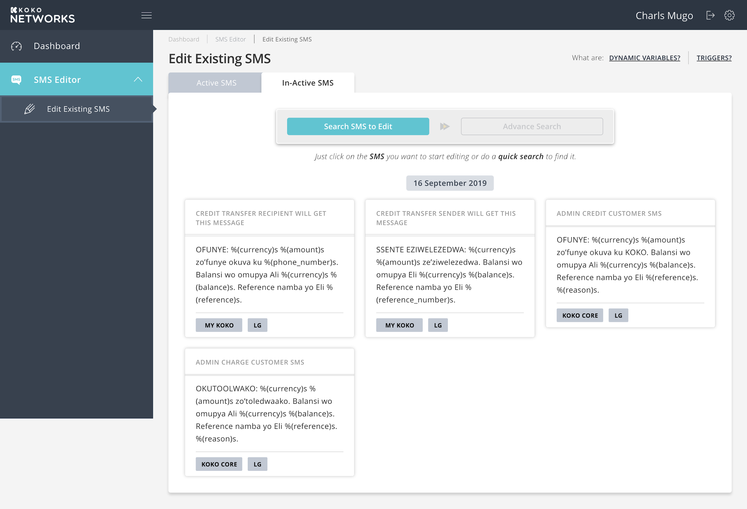
SMS Editor - Overview
Use Menu to find ‘SMS Editor’
View Active/Inactive SMSes
Open info on Dynamic Variables & Triggers
Search/filter bar
Date of most recent SMS edits
SMS cards

Slide 6
Understand SMS Dynamic Variables & Triggers
Users can view information on all the dynamic variables
Users can view information about the existing triggers

Slide 7
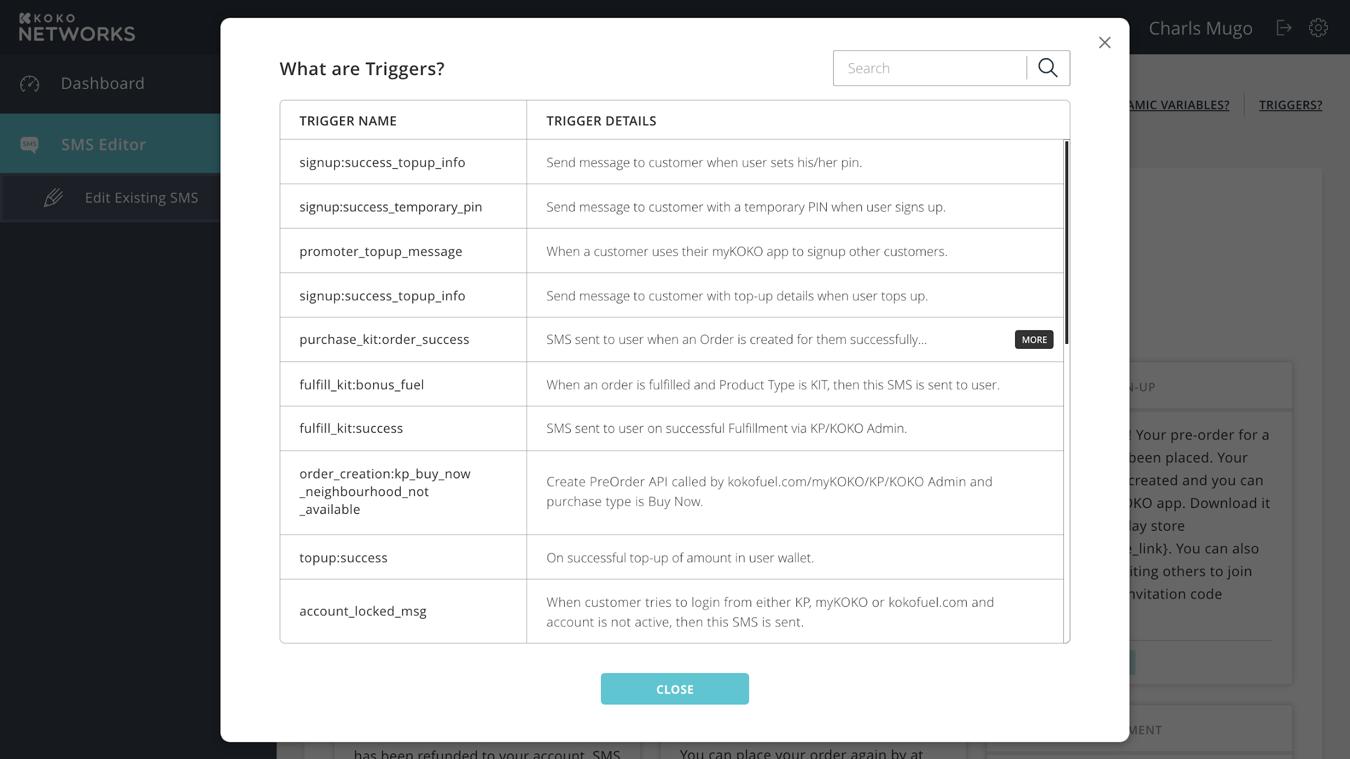
Triggers
The list of triggers and dynamic variables and their descriptions can be found at the top left section of the SMS editor
Each trigger has a unique name and description

Slide 8
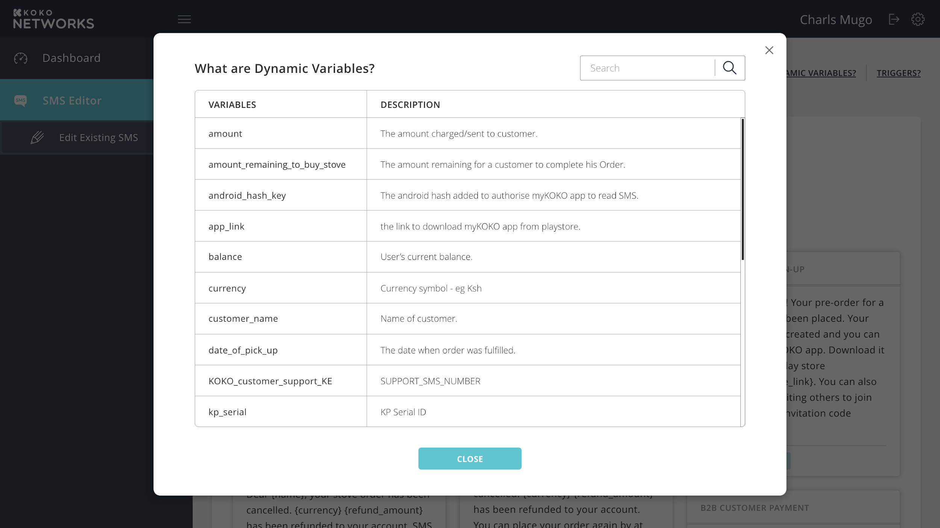
Dynamic Variables
The list of triggers and dynamic variables and their descriptions can be found at the top left section of the SMS editor
Each dynamic variable has a unique name and description

Slide 9
Find specific SMS.
Users can search for a particular SMS

Slide 10
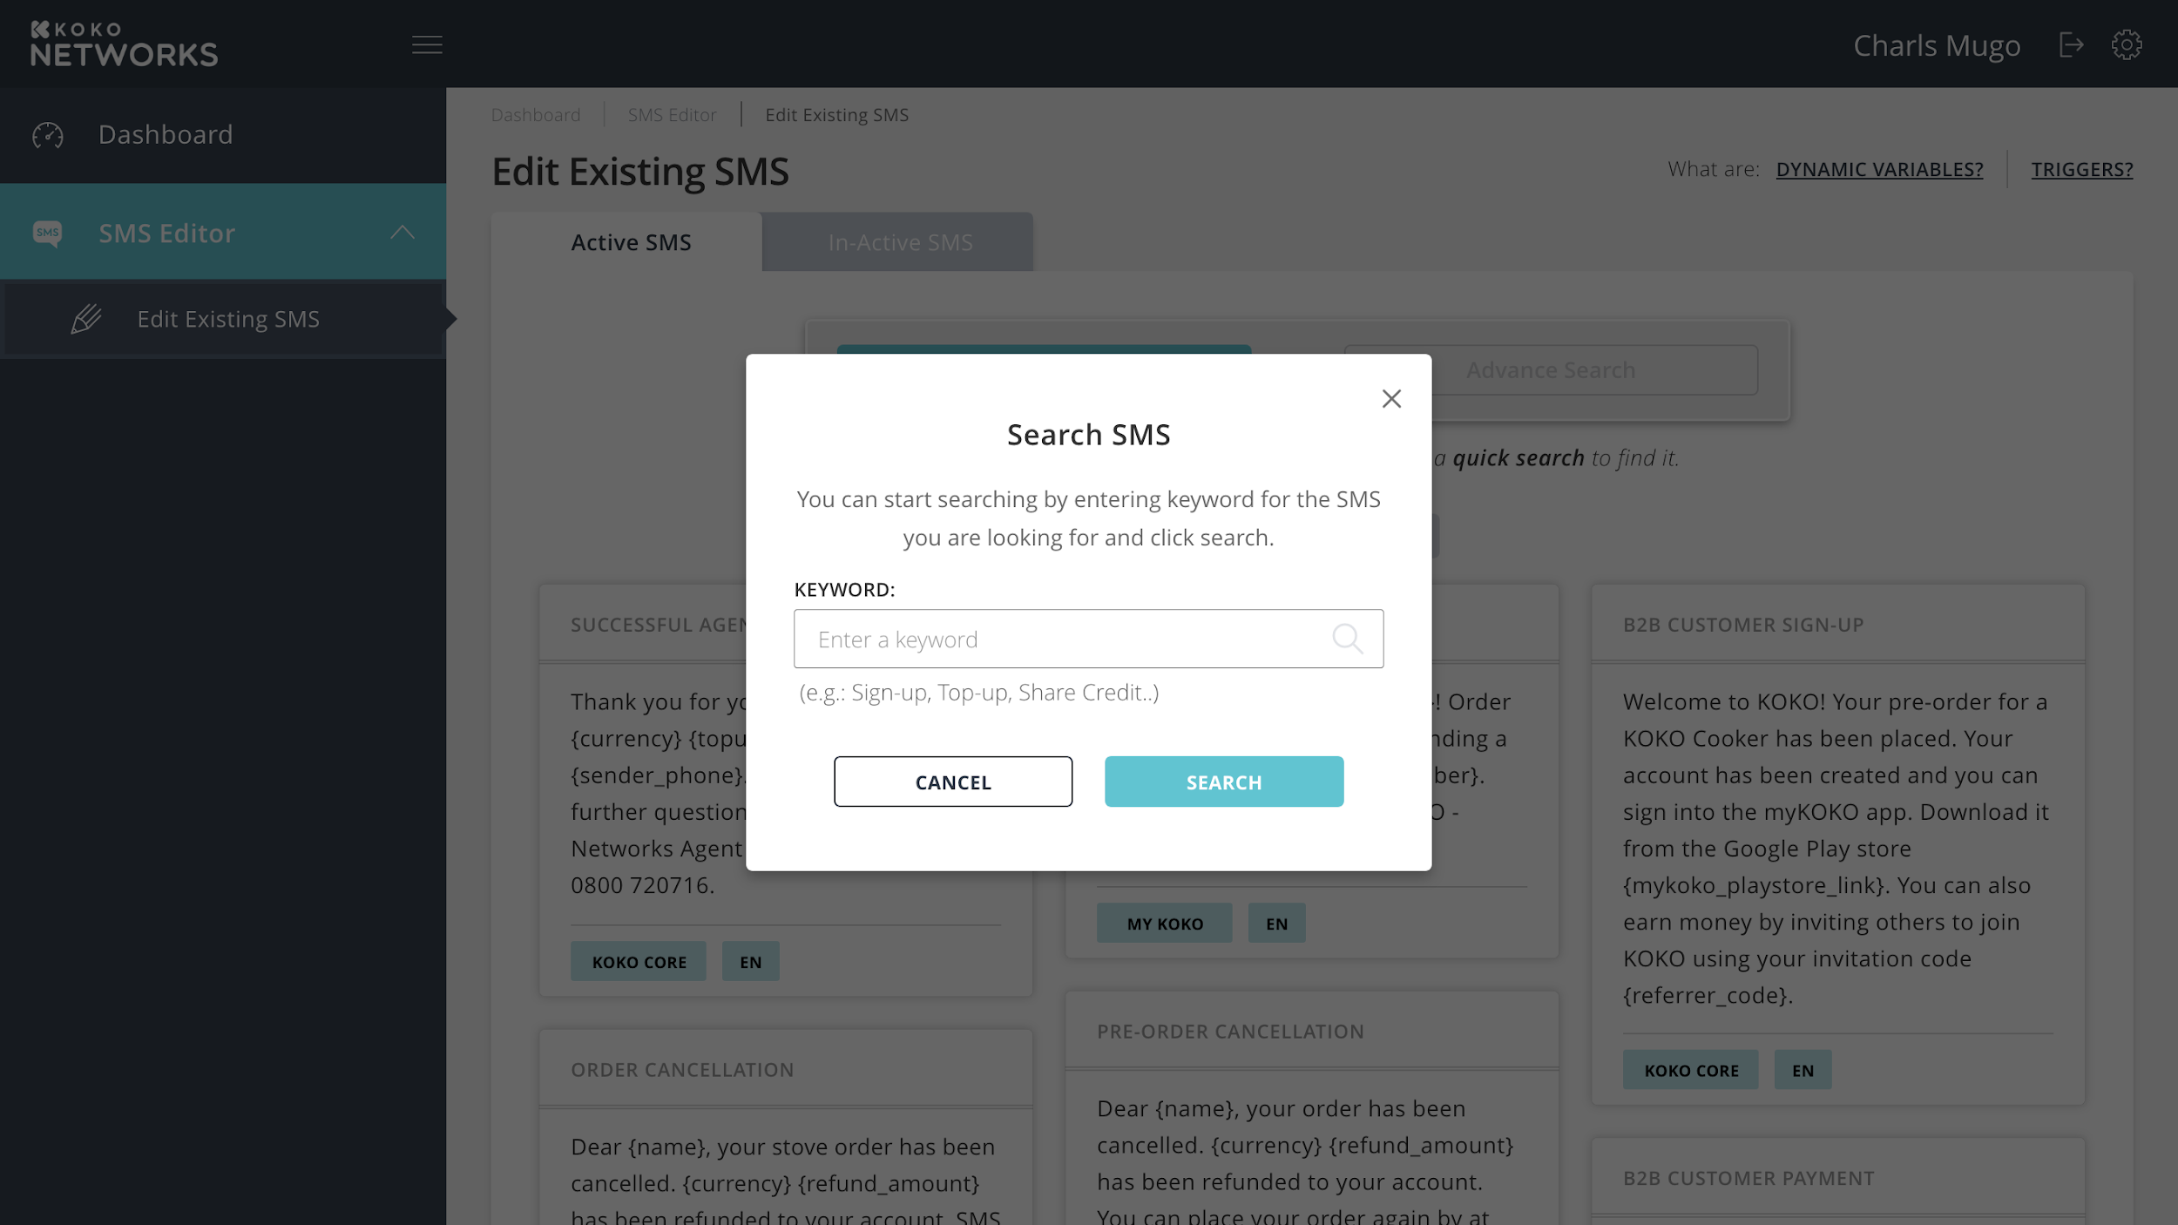
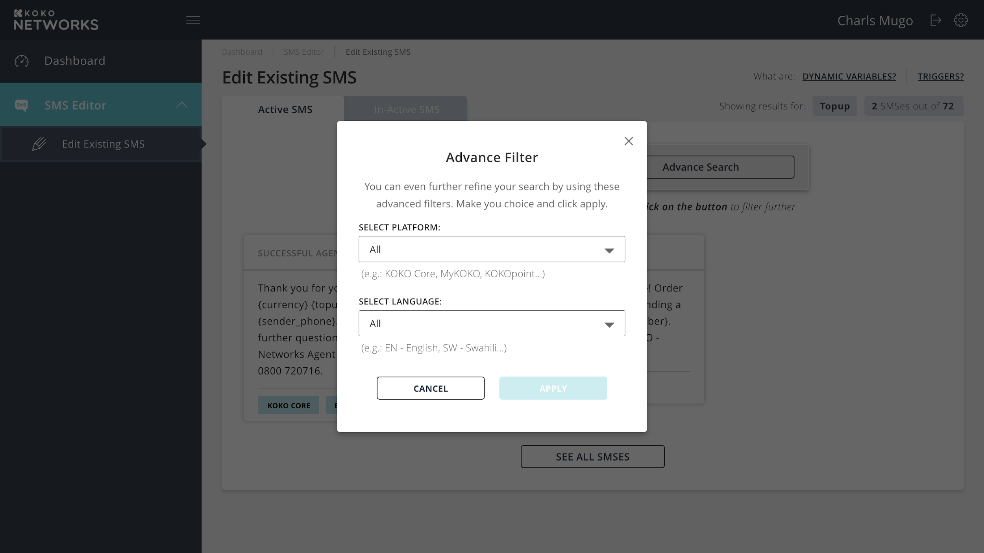
Search for SMS - Keywords & Advanced Filter
Users can search for an SMS based on particular keywords
Users can also use the Advance Search to filter SMSes by specific platforms and languages

Slide 11
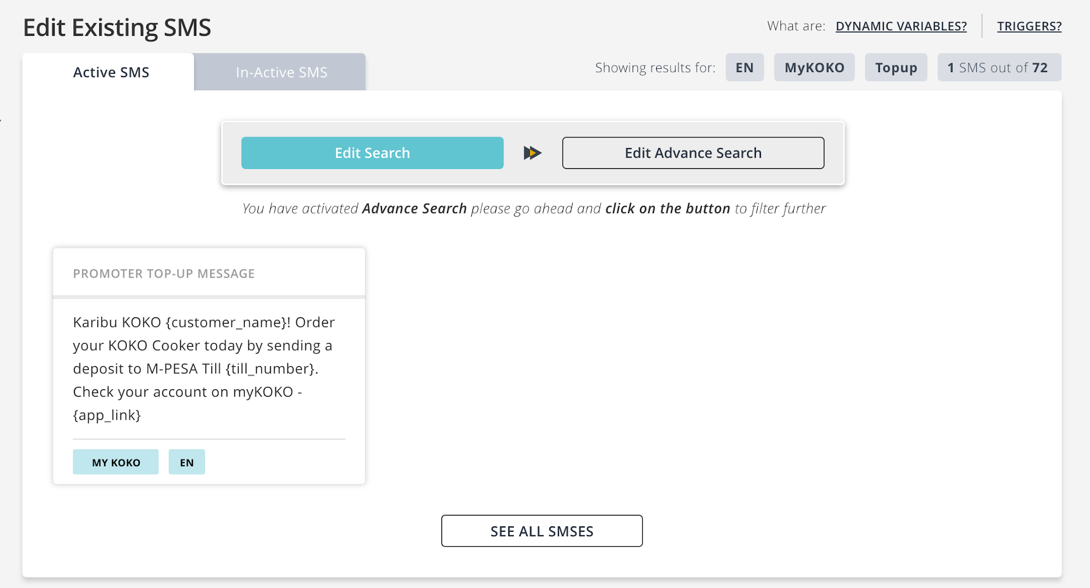
Search/Filter View
If users have searched for keywords or used the Advance Filter, the SMSes related to that search/filter are displayed on the list of SMSes.
Information on the keywords/filter are displayed on the top-left.
Users can click on ‘See all SMSes’ to remove the search/filtered view and return the default view of all SMSes

Slide 12
Edit SMS.
Users can search for a particular SMS

Slide 13
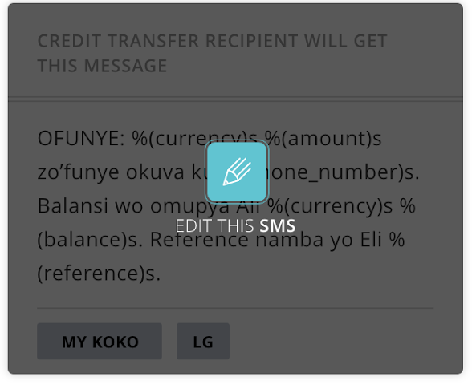
SMS Cards
Each SMS is displayed in cards which have:
The description of the SMS
The copy of the SMS
The platform involved when this SMS is sent eg. myKOKO app
The language of the SMS
To edit a specific SMS, the user clicks on the SMS card. This opens the page to edit the SMS.

Slide 14
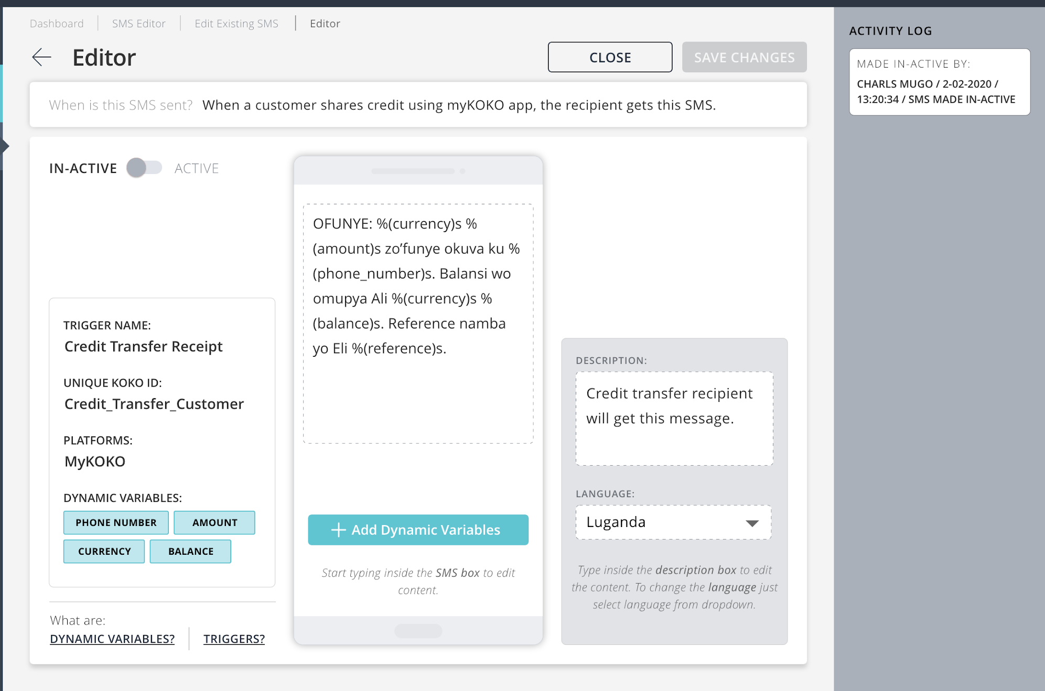
Edit SMS Screen
Change the status of an SMS from ‘Active’ to In-Active’ by switching the toggle.
View SMS edit history
Edit copy of SMS by clicking and typing here
Change description of SMS here.
Add dynamic variables to SMS here
Change language from this dropdown

Slide 15
Edit Restrictions to Note
Dynamic variables can only be added if they already exist in the system. Users cannot make up new variables on the go.
Making an SMS In-active will stop the SMS from being sent to customers; and vice versa.
Triggers cannot be edited/created by users.
SMSes cannot be reassigned to different triggers.
Only users with ‘edit’ permissions can successfully make changes to SMSes

Slide 16
Alice Morton & Nyawira Njoroge

